Slide 1
Deep Generative Models: An Overview
Yidong Chai^{1,2}, Weifeng Li^{1,3}, Hsinchun Chen¹
¹ Artificial Intelligence Laboratory, The University of Arizona
² Tsinghua University
³ University of Georgia

Slide 2
Acknowledgements
Many of the pictures, results, and other materials are taken from:
Aaron Courville, University of Montreal
Diederik P. Kingma, University of Amsterdam/OpenAI/GoogleBrain
Eric Xing, Carnegie Mellon University/Petuum Inc.
Geoffrey Hinton, Google & University of Toronto
Ian J. Goodfellow, Google Brain
Stefano Eron, Stanford University
Yoshua Bengio, Universite de Montreal

Slide 3
Outline
Introduction
Traditional Generative Models
Deep Generative Models
Example Applications
Deep Belief Networks
Variational Autoencoder
Technical novelties
Implementation
Generative Adversarial Networks
Technical novelties
Implementation
Research Example: Motion Sensor-Based Fall Detection and Prediction
Conclusions
Appendix

Slide 4
Outline
Introduction
Traditional Generative Models
Deep Generative Models
Example Applications
Deep Belief Networks
Variational Autoencoder
Technical novelties
Implementation
Generative Adversarial Networks
Technical novelties
Implementation
Research Example: Motion Sensor-Based Fall Detection and Prediction
Conclusions
Appendix

Slide 5
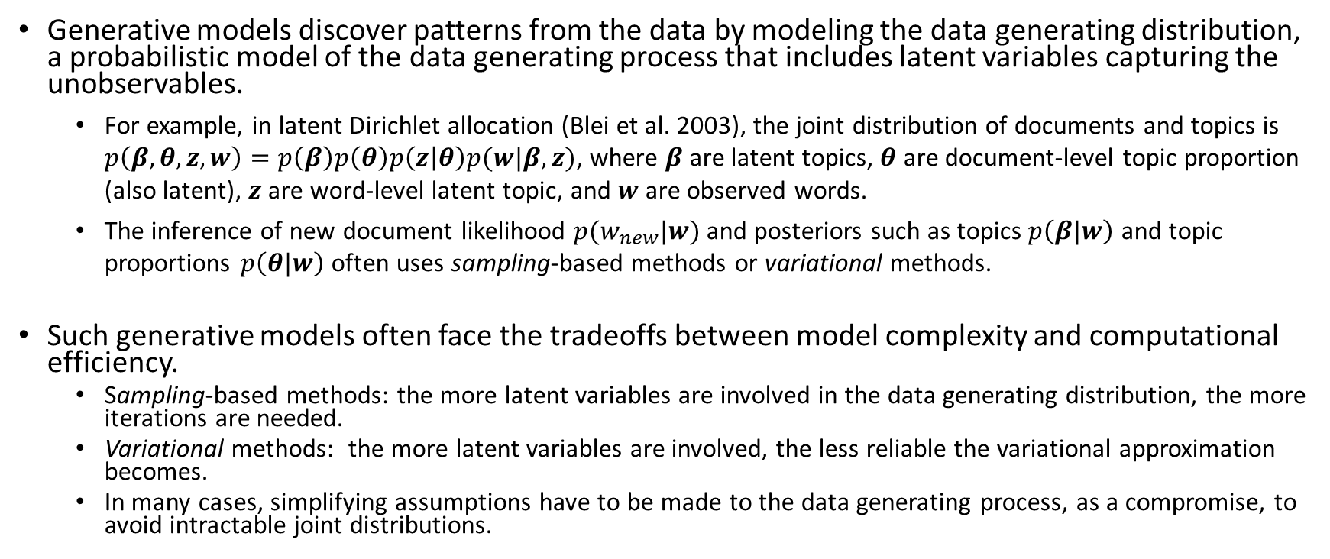
Traditional Generative Models
Generative models discover patterns from the data by modeling the data generating distribution, a probabilistic model of the data generating process that includes latent variables capturing the unobservables.
For example, in latent Dirichlet allocation (Blei et al. 2003), the joint distribution of documents and topics is $p\left(β,θ,z,w\right)=p\left(β\right)p\left(θ\right)p\left(z | θ\right)p(w|β,z)$, where $β$ are latent topics, $θ$ are document-level topic proportion (also latent), $z$ are word-level latent topic, and $w$ are observed words.
The inference of new document likelihood $p(w_{new}|w)$ and posteriors such as topics $p\left(β|w\right)$ and topic proportions $p\left(θ|w\right)$ often uses sampling-based methods or variational methods.
Such generative models often face the tradeoffs between model complexity and computational efficiency.
Sampling-based methods: the more latent variables are involved in the data generating distribution, the more iterations are needed.
Variational methods: the more latent variables are involved, the less reliable the variational approximation becomes.
In many cases, simplifying assumptions have to be made to the data generating process, as a compromise, to avoid intractable joint distributions.

Slide 6
Deep Generative Models
Neural network models are known for accommodating for complex non-linear relations, and are now equipped with improved computational efficiency (attributed to the recent development in deep learning.)
Deep generative models couple generative models with neural networks in order to model complex data generating distributions with reasonable computational efficiency.
Modeling data generating distributions with neural networks has at least three notable advantages:
Neural networks can model a wide range of complex data generating distributions, which are intractable under traditional generative modeling without making simplifying assumptions.
There is no need to prespecify data generating processes, because the neural network would learn the data generating process directly from the data. As a result, the risk of misspecified data generating processes is significantly reduced.
The data generating distributions learned by neural networks are empirically found to be closer to the actual ones than traditional generative models.
The state-of-the-art deep generative models are now capable of effectively modeling complex data generating processes of various data types, including image, speech, and text.
The next few slides showcase the state-of-the-art applications of deep generative models in these contexts.

Slide 7
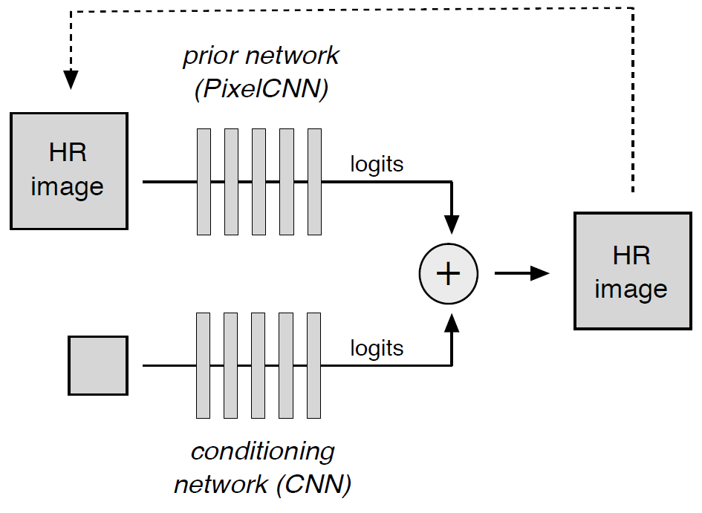
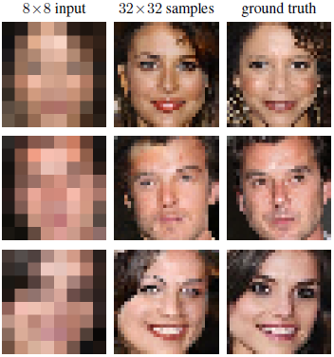
Application: Image Super Resolution
Image data generating distributions can be used for recovering a plausible high-resolution image given a low resolution input.
CNN’s are used to model the conditional distribution of a pixel and the prior distribution of a high-resolution pixel.
8x8 input
output
Ground truth
Fig. 1. An Example of Using Deep Generative Models for Image Super Resolution
Dahl, R., Norouzi, M., & Shlens, J. (2017). Pixel Recursive Super Resolution. In 2017 IEEE International Conference on Computer Vision (ICCV) (pp. 5449-5458).
Notes:
Dahl, R., Norouzi, M., & Shlens, J. (2017). Pixel Recursive Super Resolution. In 2017 IEEE International Conference on Computer Vision (ICCV) (pp. 5449-5458).

Slide 8
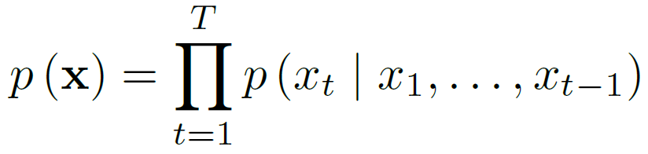


Application: Text-to-Speech (TTS)
Learned audio features
The joint probability of a waveform:
Output
Modeling the joint probability with a stack of causal convolutional layers
van den Oord, A., Dieleman, S., Zen, H., Simonyan, K., Vinyals, O., Graves, A., ... & Kavukcuoglu, K. (2016) WaveNet: A Generative Model for Raw Audio. In 9th ISCA Speech Synthesis Workshop (pp. 125-125).
Notes:
https://deepmind.com/blog/wavenet-generative-model-raw-audio/

Slide 9
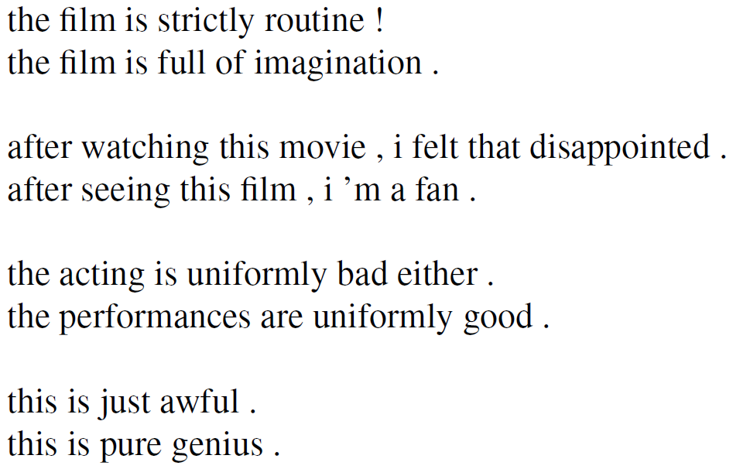
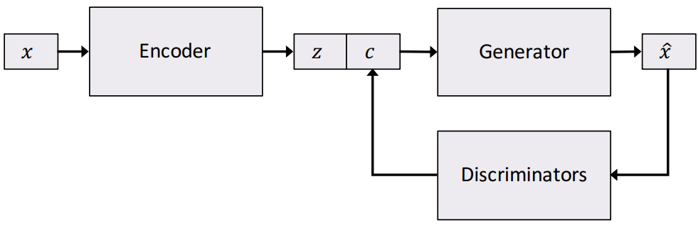
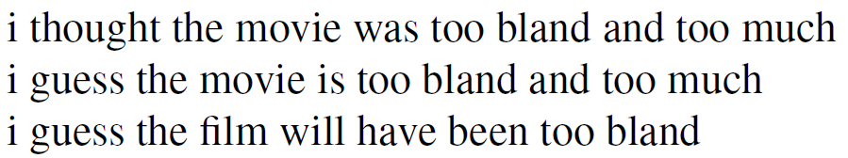
Application: Controllable Text Generation
Generate plausible sentences with designated semantic structures (e.g., sentiment, tense, etc.).
Generated texts with negative/positive sentiment
Input text
Text generating statistics
Designated semantic structure
Output text
Text generating distribution
Generated texts with varying tense
Hu, Z., Yang, Z., Liang, X., Salakhutdinov, R., & Xing, E. P. (2017). Toward Controlled Generation of Text. In International Conference on Machine Learning (pp. 1587-1596).

Slide 10
Deep Generative Models
In this set of slides, we will introduce the three most representative deep generative models: Deep Belief Networks, Variational Autoencoders, and Generative Adversarial Networks.
Deep Belief Networks (DBN) employ layer-wise generative modeling to initialize each layer and simultaneously capture multiple levels of data representation.
Started the recent deep learning renaissance
Hinton, G. E, Osindero, S., and Teh, Y. W. (2006). A fast learning algorithm for deep belief nets. Neural Computation, 18:1527-1554.
Variational Autoncoder (VAE) is a variational algorithm that infers the statistical characteristics of latent variables using an autoencoder neural network architecture.
Kingma, D. P., & Welling, M. (2014). Auto-Encoding Variational Bayes. In Proceedings of International Conference on Learning Representations (ICLR).
Generative Adversarial Networks (GAN) train two neural networks (a generative neural network and a discriminative neural network) contesting with each other in a zero-sum game framework.
Goodfellow, I., Pouget-Abadie, J., Mirza, M., Xu, B., Warde-Farley, D., Ozair, S., … Bengio, Y. (2014). Generative Adversarial Nets. In Advances in Neural Information Processing Systems 27 (pp. 2672–2680).

Slide 11
Outline
Introduction
Traditional Generative Models
Deep Generative Models
Example Applications
Deep Belief Networks
Variational Autoencoder
Technical novelties
Implementation
Generative Adversarial Networks
Technical novelties
Implementation
Research Example: Motion Sensor-Based Fall Detection and Prediction
Conclusions
Appendix

Slide 12
Deep Belief Networks
A deep belief network (DBN) is a probabilistic, generative model made up of multiple layers of hidden units.
A composition of simple learning modules that make up each layer
A DBN can be used to generatively pre-train a deep neural network by using the learned DBN weights as the initial DNN weights.
Back-propagation or other discriminative algorithms can then be applied for fine-tuning of these weights.
Advantages:
Particularly helpful when limited training data are available
These pre-trained weights are closer to the optimal weights than are randomly chosen initial weights.

Slide 13
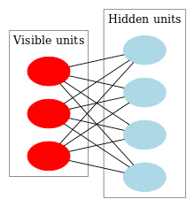
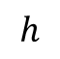
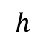
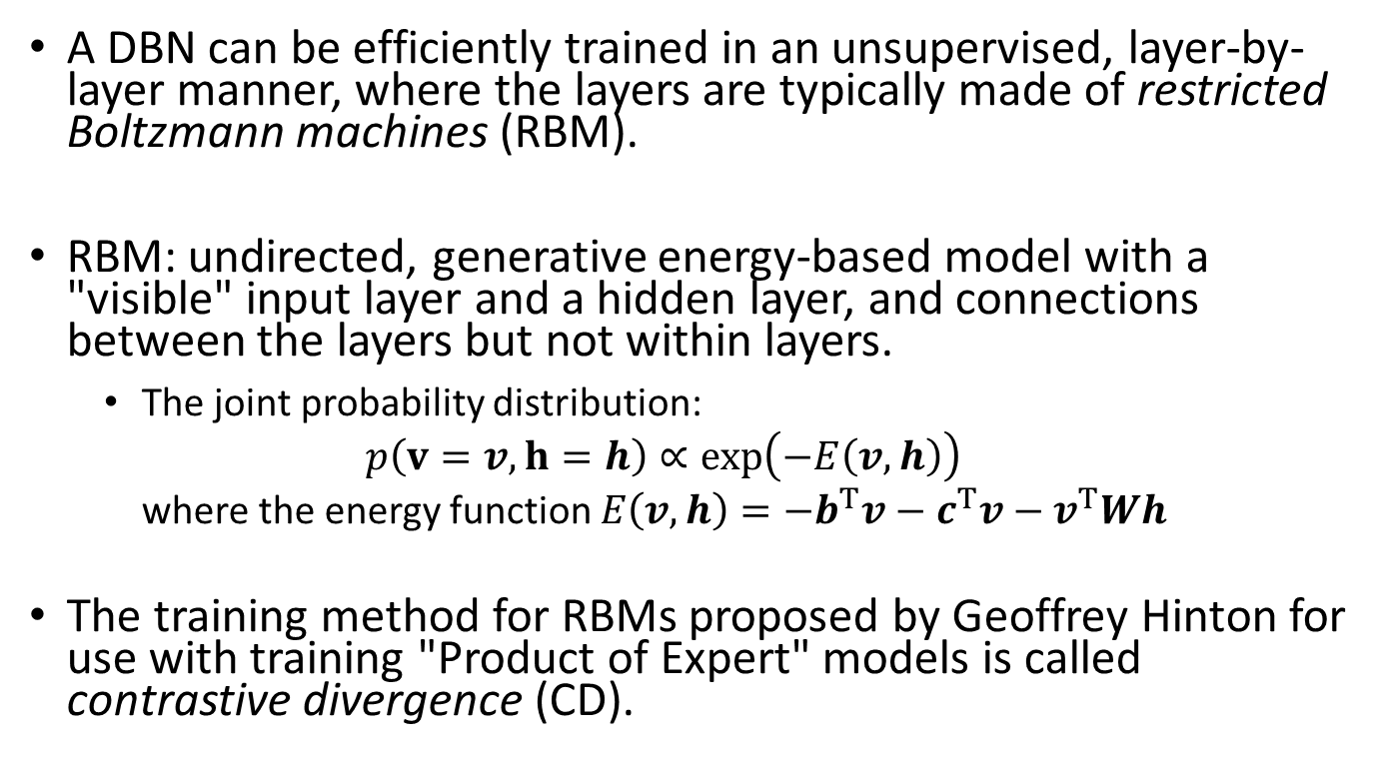
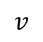
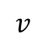
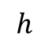
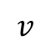
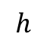
Restricted Boltzmann Machine
A DBN can be efficiently trained in an unsupervised, layer-by-layer manner, where the layers are typically made of restricted Boltzmann machines (RBM).
RBM: undirected, generative energy-based model with a "visible" input layer and a hidden layer, and connections between the layers but not within layers.
The joint probability distribution: $p\left(v=v,h=h\right)∝\exp\left(−E\left(v,h\right)\right)$ where the energy function $E\left(v,h\right)=−b^{T}v−c^{T}v−v^{T}Wh$
The training method for RBMs proposed by Geoffrey Hinton for use with training "Product of Expert" models is called contrastive divergence (CD).
$$h$$
$$v$$
$$h$$
$$v$$
$$h$$
$$v$$
$$h$$
Fig. 2 An RBM with fully connected visible and hidden units
*Note there are no hidden-hidden or visible-visible connections.

Slide 14
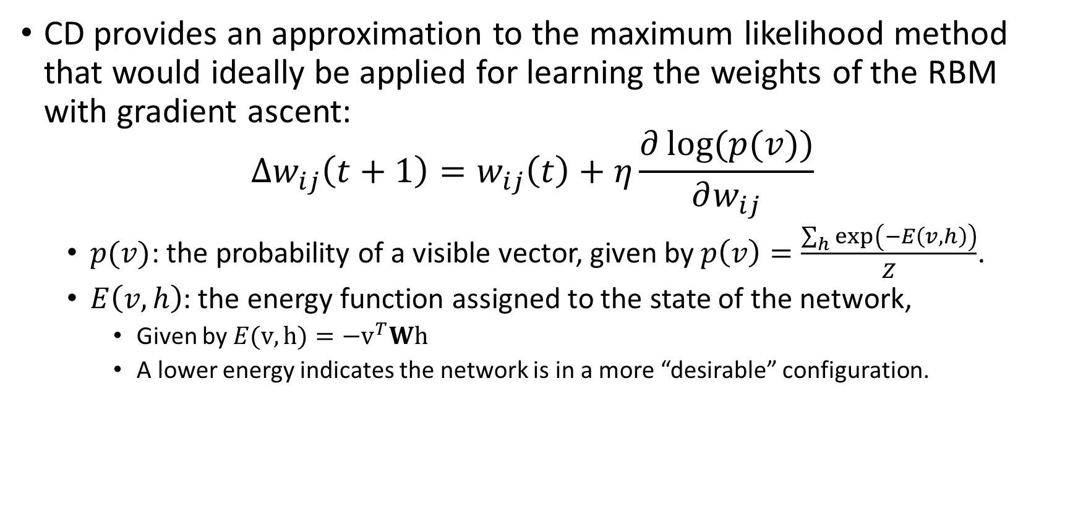
Contrastive Divergence (CD)
CD provides an approximation to the maximum likelihood method that would ideally be applied for learning the weights of the RBM with gradient ascent: $∆w_{ij}\left(t+1\right)=w_{ij}\left(t\right)+η\frac{∂\log{(p(v))}}{∂w_{ij}}$
$p(v)$: the probability of a visible vector, given by $p\left(v\right)=\frac{\sum_{h}{\exp\left(−E\left(v,h\right)\right)}}{Z}$.
$E\left(v,h\right)$: the energy function assigned to the state of the network,
Given by $E(v,h)=−v^{T}Wh$
A lower energy indicates the network is in a more “desirable” configuration.

Slide 15
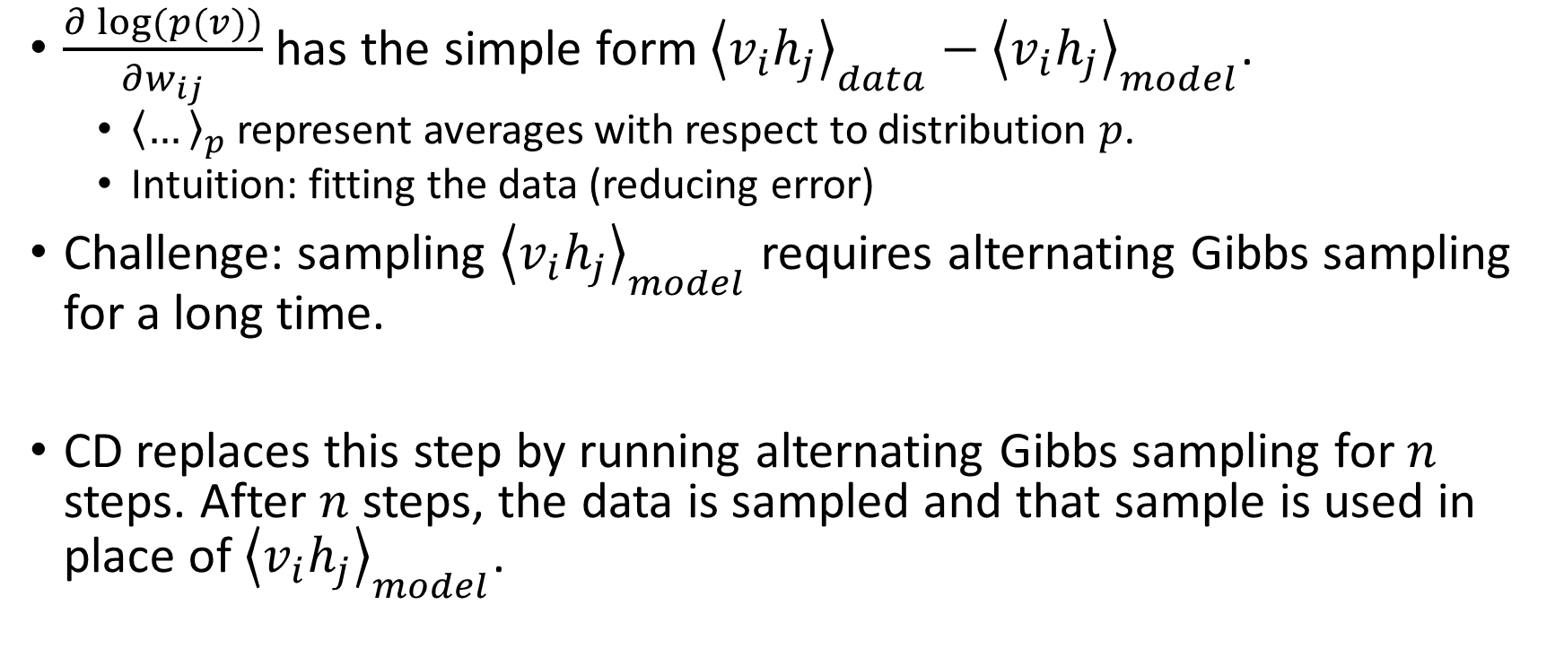
Contrastive Divergence (CD)
$\frac{∂\log{(p(v))}}{∂w_{ij}}$ has the simple form ${\left\langle v_{i}h_{j}\right\rangle }_{data}−{\left\langle v_{i}h_{j}\right\rangle }_{model}$.
${\left\langle …\right\rangle }_{p}$ represent averages with respect to distribution $p$.
Intuition: fitting the data (reducing error)
Challenge: sampling ${\left\langle v_{i}h_{j}\right\rangle }_{model}$ requires alternating Gibbs sampling for a long time.
CD replaces this step by running alternating Gibbs sampling for $n$ steps. After $n$ steps, the data is sampled and that sample is used in place of ${\left\langle v_{i}h_{j}\right\rangle }_{model}$.

Slide 16
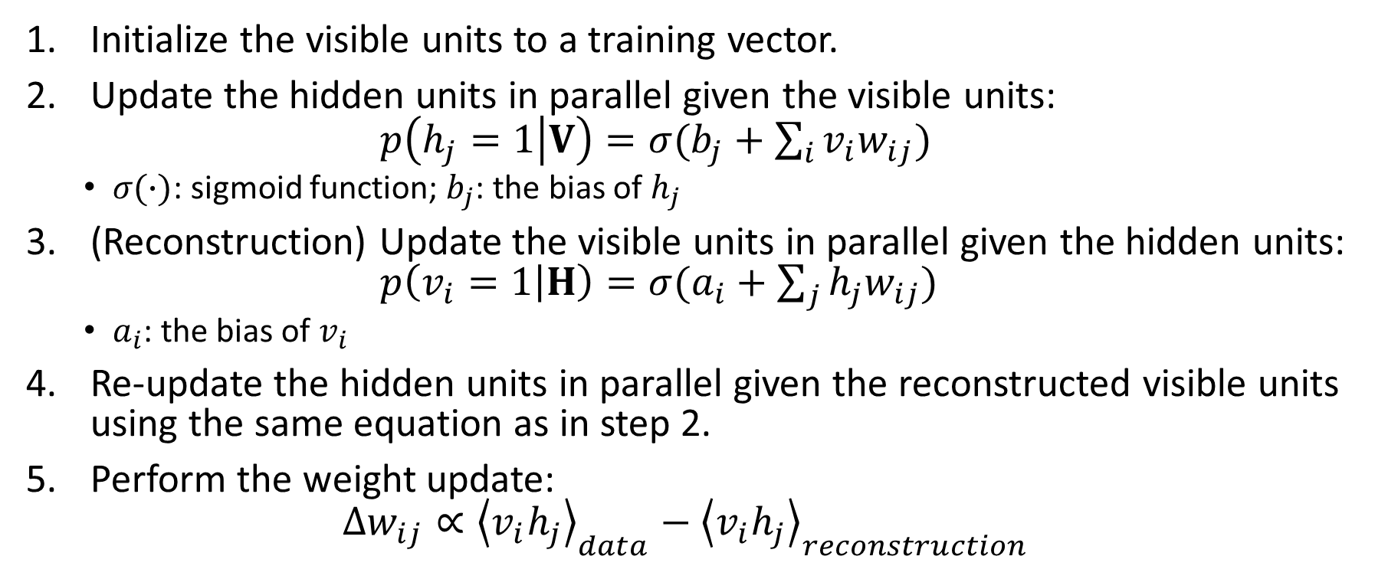
The CD procedure
Initialize the visible units to a training vector.
Update the hidden units in parallel given the visible units: $p\left(h_{j}=1 | V\right)=σ(b_{j}+\sum_{i}{v_{i}w_{ij}})$
$σ(∙)$: sigmoid function; $b_{j}$: the bias of $h_{j}$
(Reconstruction) Update the visible units in parallel given the hidden units: $p\left(v_{i}=1 | H\right)=σ(a_{i}+\sum_{j}{h_{j}w_{ij}})$
$a_{i}$: the bias of $v_{i}$
Re-update the hidden units in parallel given the reconstructed visible units using the same equation as in step 2.
Perform the weight update: $∆w_{ij}∝{\left\langle v_{i}h_{j}\right\rangle }_{data}−{\left\langle v_{i}h_{j}\right\rangle }_{reconstruction}$

Slide 17
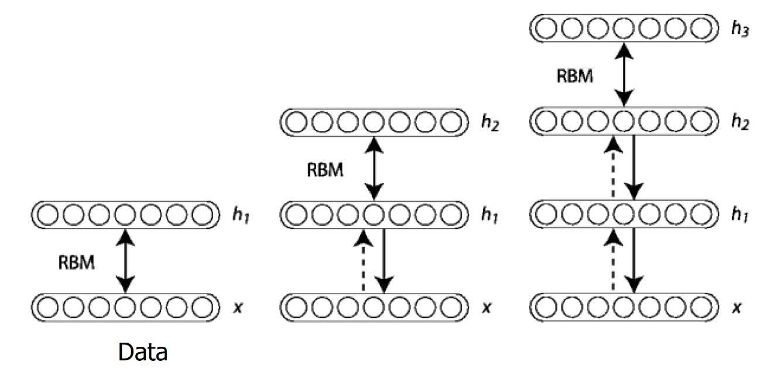
Deep Belief Network Architecture: Layer-wise Training
Once an RBM is trained, another RBM is "stacked" atop it, taking its input from the final already-trained layer.
The new visible layer is initialized to a training vector, and values for the units in the already-trained layers are assigned using the current weights and biases.
The new RBM is then trained with the CD procedure.
This whole process is repeated until some desired stopping criterion is met.
Fig. 3. DBN Architecture

Slide 18
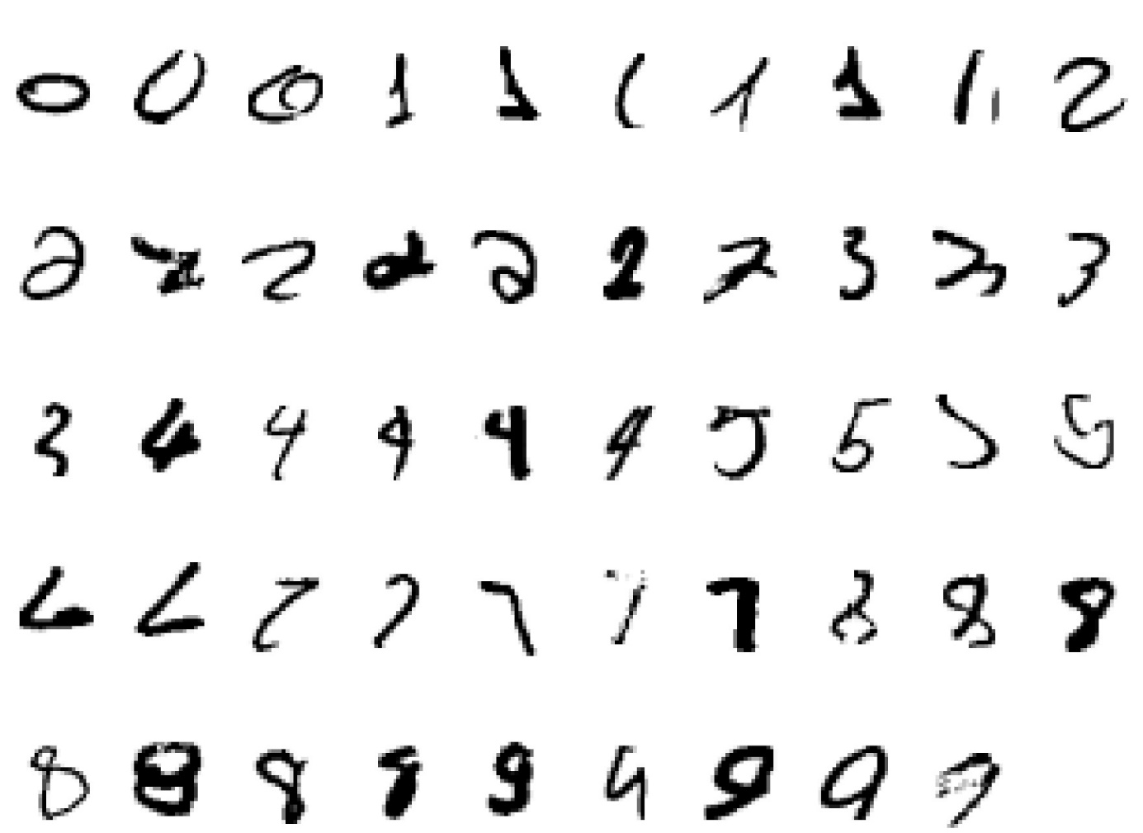
DBN Example: Hand-written Digit Recognition
Input:
Fig. 4. Hand-written Digits

Slide 19
DBN Example: Hand-written Digit Recognition
2000 top-level neurons
The top two layers form an associative memory whose energy landscape models the low dimensional manifolds of the digits.
10 label neurons
500 neurons
The model learns to generate combinations of labels and images.
To perform recognition we start with a neutral state of the label units and do an up-pass from the image followed by a few iterations of the top-level associative memory.
500 neurons
28 x 28 pixel image
Fig. 5. Hand-written Digit Recognition

Slide 20
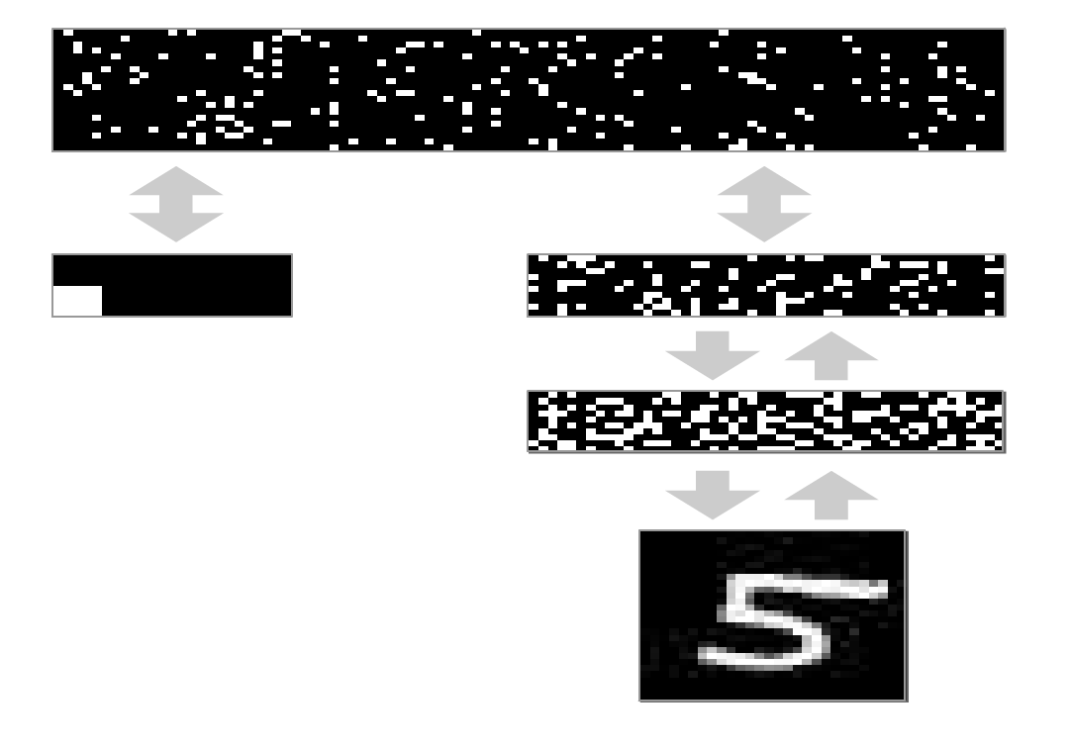
DBN Example: Hand-written Digit Recognition
2000 top-level neurons
0
1
2
3
4
500 neurons
5
6
7
8
9
10 label neurons
500 neurons
Hidden representations of the data generating process
28 x 28 pixel image
Fig. 6. Hand-written Digit Recognition
Notes:
I don’t know how to name this figure. I think more explanation is needed.

Slide 21
DBN Example: Hand-written Digit Recognition
How well does it discriminate on MNIST test set (hand-written image) with no extra information about geometric distortions?
Generative model based on RBM’s 1.25% (error rate)
Support Vector Machine (Decoste et. al.) 1.4%
Backprop with 1000 hiddens (Platt) ~1.6%
Backprop with 500 -->300 hiddens ~1.6%
K-Nearest Neighbor ~ 3.3%
See Le Cun et. al. 1998 for more results
Its better than backprop and much more neurally plausible because the neurons only need to send one kind of signal, and the teacher can be another sensory input.

Slide 22
Outline
Introduction
Traditional Generative Models
Deep Generative Models
Example Applications
Deep Belief Networks
Variational Autoencoder
Technical novelties
Implementation
Generative Adversarial Networks
Technical novelties
Implementation
Research Example: Motion Sensor-Based Fall Detection and Prediction
Conclusions
Appendix

Slide 23
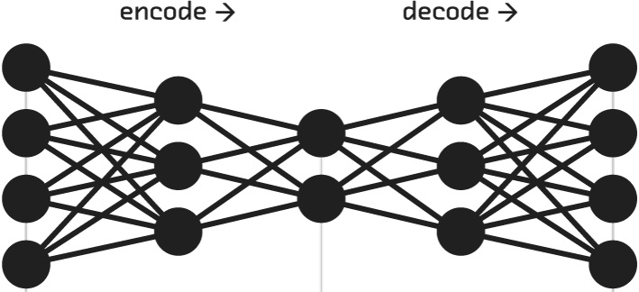
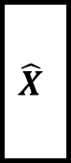

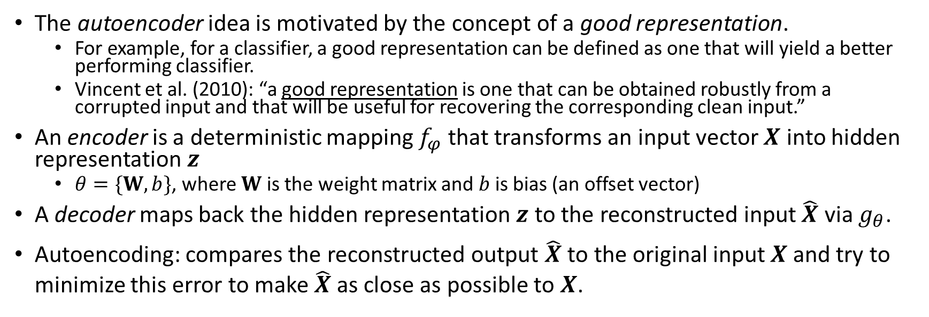
Autoencoder
The autoencoder idea is motivated by the concept of a good representation.
For example, for a classifier, a good representation can be defined as one that will yield a better performing classifier.
Vincent et al. (2010): “a good representation is one that can be obtained robustly from a corrupted input and that will be useful for recovering the corresponding clean input.”
An encoder is a deterministic mapping $f_{φ}$ that transforms an input vector $X$ into hidden representation $z$
$θ=\{W,b\}$, where $W$ is the weight matrix and $b$ is bias (an offset vector)
A decoder maps back the hidden representation $z$ to the reconstructed input $\hat{X}$ via $g_{θ}$.
Autoencoding: compares the reconstructed output $\hat{X}$ to the original input $X$ and try to minimize this error to make $\hat{X}$ as close as possible to $X$.
Hidden Representation
$$X$$
Encoder neural network
Decoder neural network
$$\hat{X}$$
z
Fig. 7. Autoencoder Architecture

Slide 24
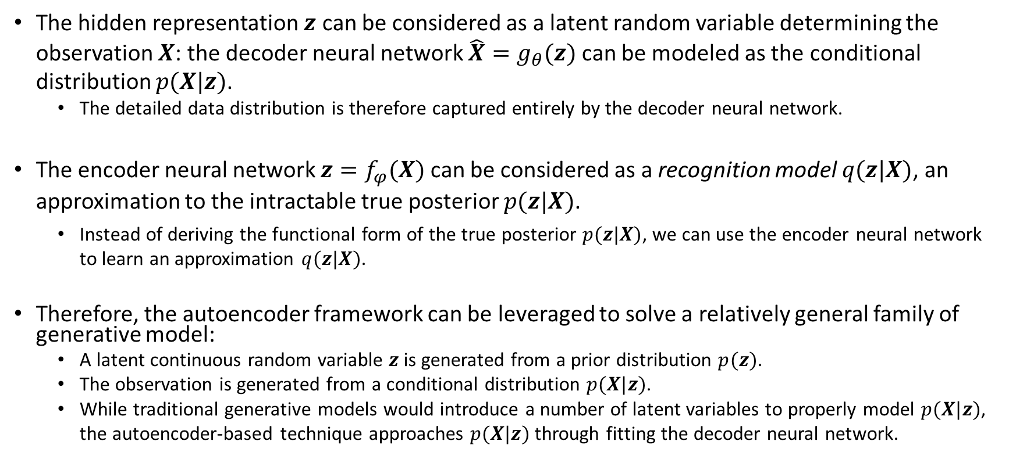
A Generative Modeling Perspective of Autoencoders
The hidden representation $z$ can be considered as a latent random variable determining the observation $X$: the decoder neural network $\hat{X}=g_{θ}(z)$ can be modeled as the conditional distribution $p(X|z)$.
The detailed data distribution is therefore captured entirely by the decoder neural network.
The encoder neural network $z=f_{φ}(X)$ can be considered as a recognition model $q(z|X)$, an approximation to the intractable true posterior $p(z|X)$.
Instead of deriving the functional form of the true posterior $p(z|X)$, we can use the encoder neural network to learn an approximation $q(z|X)$.
Therefore, the autoencoder framework can be leveraged to solve a relatively general family of generative model:
A latent continuous random variable $z$ is generated from a prior distribution $p(z)$.
The observation is generated from a conditional distribution $p(X|z)$.
While traditional generative models would introduce a number of latent variables to properly model $p(X|z)$, the autoencoder-based technique approaches $p(X|z)$ through fitting the decoder neural network.

Slide 25
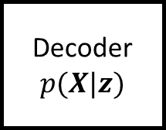
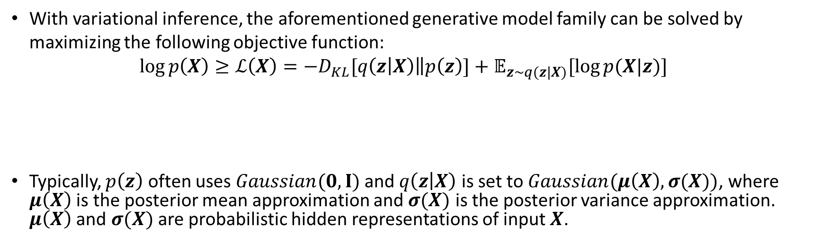
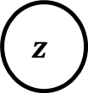
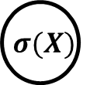
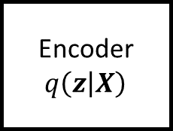
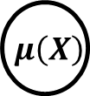

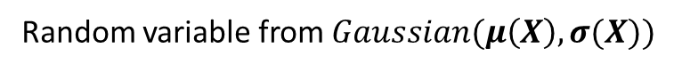
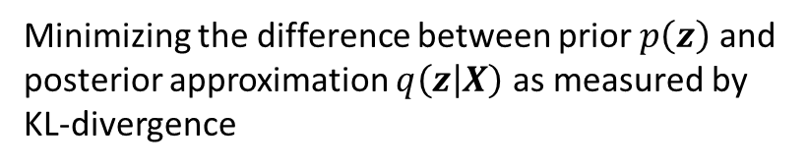
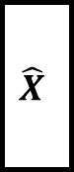
Variational Autoencoder
With variational inference, the aforementioned generative model family can be solved by maximizing the following objective function: $\log{p\left(X\right)≥ℒ\left(X\right)=−D_{KL}[q\left(z | X\right)\left\|p\left(z\right)\right.]+𝔼_{z\sim q(z|X)}[\log{p(X|z)}]}$
Typically, $p\left(z\right)$ often uses $Gaussian(0,I)$ and $q\left(z | X\right)$ is set to $Gaussian(μ\left(X\right),σ(X))$, where $μ\left(X\right)$ is the posterior mean approximation and $σ(X)$ is the posterior variance approximation. $μ\left(X\right)$ and $σ(X)$ are probabilistic hidden representations of input $X$.
Minimizing the difference between prior $p\left(z\right)$ and posterior approximation $q\left(z | X\right)$ as measured by KL-divergence
Maximizing the likelihood of the observed data as specified by the generative model
Random variable from $Gaussian(μ\left(X\right),σ(X))$
$$μ\left(X\right)$$
$$X$$
Encoder $q\left(z | X\right)$
Decoder $p(X|z)$
$$\hat{X}$$
$$z$$
$$σ(X)$$
Fig. 8. Variational Autoencoder Architecture

Slide 26
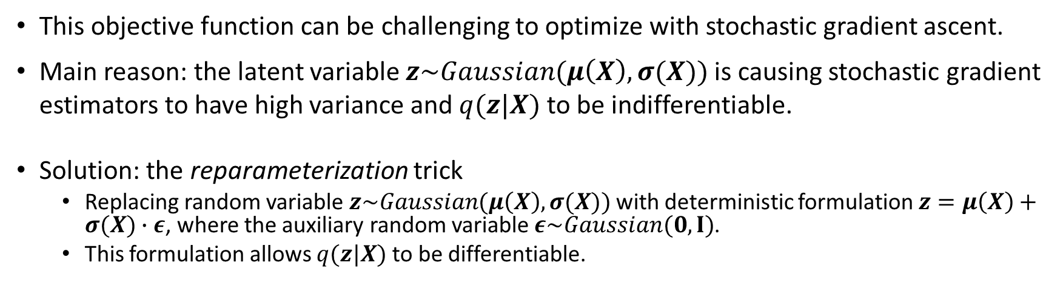
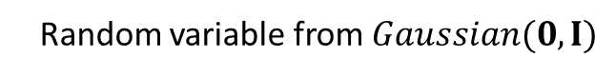
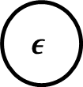


Variational Autoencoder: the Famous Reparameterization Trick
This objective function can be challenging to optimize with stochastic gradient ascent.
Main reason: the latent variable $z\sim Gaussian(μ\left(X\right),σ(X))$ is causing stochastic gradient estimators to have high variance and $q(z|X)$ to be indifferentiable.
Solution: the reparameterization trick
Replacing random variable $z\sim Gaussian(μ\left(X\right),σ(X))$ with deterministic formulation $z=μ\left(X\right)+σ(X)∙ε$, where the auxiliary random variable $ε\sim Gaussian(0,I)$.
This formulation allows $q(z|X)$ to be differentiable.
Deterministic formulation
$$μ\left(X\right)$$
$$X$$
Encoder $q\left(z | X\right)$
Decoder $p(X|z)$
$$\hat{X}$$
$$σ(X)$$
$$z$$
$$ε$$
Random variable from $Gaussian(0,I)$
Fig. 9. Variational Autoencoder with Reparameterization Trick

Slide 27
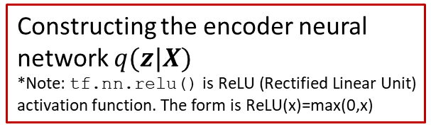
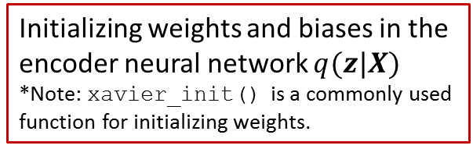
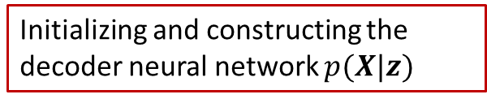
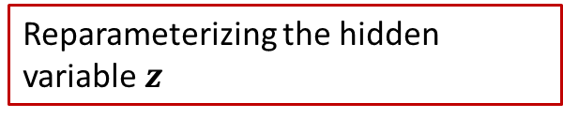
TensorFlow (Python) VAE Example: Hand-written Digits Generation
Initializing weights and biases in the encoder neural network $q(z|X)$
*Note: xavier_init() is a commonly used function for initializing weights.
Q_W1 = tf.Variable(xavier_init([X_dim, h_dim]))
Q_b1 = tf.Variable(tf.zeros(shape=[h_dim]))
Q_W2_mu = tf.Variable(xavier_init([h_dim, z_dim]))
Q_b2_mu = tf.Variable(tf.zeros(shape=[z_dim]))
Q_W2_sigma = tf.Variable(xavier_init([h_dim, z_dim]))
Q_b2_sigma = tf.Variable(tf.zeros(shape=[z_dim]))
def Q(X):
h = tf.nn.relu(tf.matmul(X, Q_W1) + Q_b1)
z_mu = tf.matmul(h, Q_W2_mu) + Q_b2_mu
z_logvar = tf.matmul(h, Q_W2_sigma) + Q_b2_sigma
return z_mu, z_logvar
def sample_z(mu, log_var):
eps = tf.random_normal(shape=tf.shape(mu))
return mu + tf.exp(log_var / 2) * eps
P_W1 = tf.Variable(xavier_init([z_dim, h_dim]))
P_b1 = tf.Variable(tf.zeros(shape=[h_dim]))
P_W2 = tf.Variable(xavier_init([h_dim, X_dim]))
P_b2 = tf.Variable(tf.zeros(shape=[X_dim]))
def P(z):
h = tf.nn.relu(tf.matmul(z, P_W1) + P_b1)
logits = tf.matmul(h, P_W2) + P_b2
prob = tf.nn.sigmoid(logits)
return prob, logits
Constructing the encoder neural network $q(z|X)$
*Note: tf.nn.relu() is ReLU (Rectified Linear Unit) activation function. The form is ReLU(x)=max(0,x)
Reparameterizing the hidden variable $z$
Initializing and constructing the decoder neural network $p(X|z)$
*Complete python code can be found in the appendix.

Slide 28
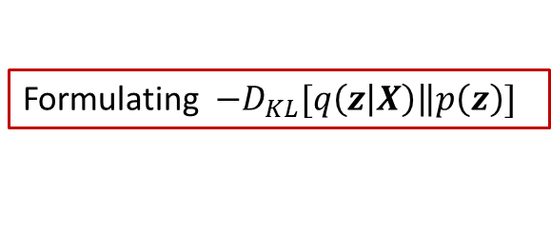
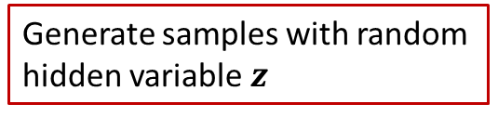
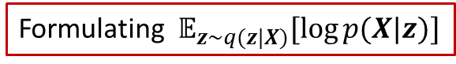
TensorFlow (Python) VAE Example: Hand-written Digits Generation
X = tf.placeholder(tf.float32, shape=[None, X_dim])
z = tf.placeholder(tf.float32, shape=[None, z_dim])
z_mu, z_logvar = Q(X)
z_sample = sample_z(z_mu, z_logvar)
_, logits = P(z_sample)
X_samples, _ = P(z)
recon_loss=tf.reduce_sum(tf.nn.sigmoid_cross_entropy_with_logit s(logits=logits, labels=X), 1)
kl_loss = 0.5 * tf.reduce_sum(tf.exp(z_logvar) + z_mu**2 - 1. - z_logvar, 1)
vae_loss = tf.reduce_mean(recon_loss + kl_loss)
solver = tf.train.AdamOptimizer().minimize(vae_loss)
sess = tf.Session()
sess.run(tf.global_variables_initializer())
for it in range(1000000):
X_mb, _ = mnist.train.next_batch(mb_size)
_, loss = sess.run([solver, vae_loss], feed_dict={X: X_mb})
samples = sess.run(X_samples, feed_dict={z:np.random.randn(16, z_dim)})
Constructing the autoencoder neural network architecture
Formulating $𝔼_{z\sim q(z|X)}[\log{p(X|z)}]$
Formulating $−D_{KL}[q\left(z | X\right)\left\|p\left(z\right)\right.]$
Objective function
Iteratively optimizing the objective function with data sampled from the MNIST dataset
Generate samples with random hidden variable $z$
*Complete python code can be found in the appendix.

Slide 29
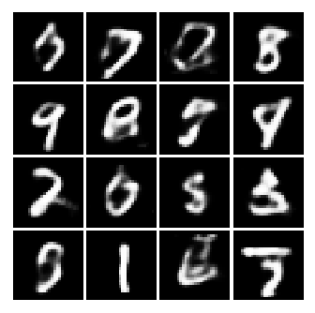
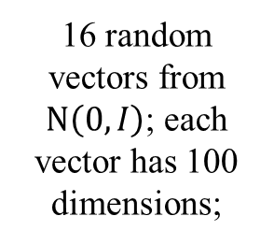
TensorFlow (Python) VAE Example: Hand-written Digits Generation
samples = sess.run(X_samples, feed_dict={z:np.random.randn(16, z_dim)})
Recall:
def P(z):
h = tf.nn.relu(tf.matmul(z, P_W1) + P_b1)
logits = tf.matmul(h, P_W2) + P_b2
prob = tf.nn.sigmoid(logits)
return prob, logits
Generated samples
Input
Decoder (P)
16 random vectors from $Ν\left(0,I\right)$; each vector has 100 dimensions;
First fully connected layer with ReLU
Second fully connected layer with Sigmoid
Plot
Fig. 10. Variational Autoencoder for Digit Generation
z:np.random.randn(16, z_dim)

Slide 30
Outline
Introduction
Traditional Generative Models
Deep Generative Models
Example Applications
Deep Belief Networks
Variational Autoencoder
Technical novelties
Implementation
Generative Adversarial Networks
Technical novelties
Implementation
Research Example: Motion Sensor-Based Fall Detection and Prediction
Conclusions
Appendix

Slide 31
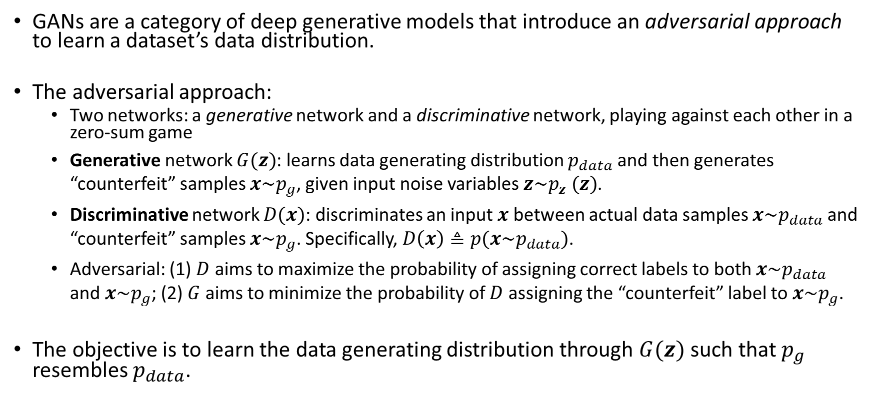
Generative Adversarial Networks (GAN)
GANs are a category of deep generative models that introduce an adversarial approach to learn a dataset’s data distribution.
The adversarial approach:
Two networks: a generative network and a discriminative network, playing against each other in a zero-sum game
Generative network $G(z)$: learns data generating distribution $p_{data}$ and then generates “counterfeit” samples $x\sim p_{g}$, given input noise variables $z\sim p_{z} (z)$.
Discriminative network $D(x)$: discriminates an input $x$ between actual data samples $x\sim p_{data}$ and “counterfeit” samples $x\sim p_{g}$. Specifically, $D\left(x\right)≜p(x\sim p_{data})$.
Adversarial: (1) $D$ aims to maximize the probability of assigning correct labels to both $x\sim p_{data}$ and $x\sim p_{g}$; (2) $G$ aims to minimize the probability of $D$ assigning the “counterfeit” label to $x\sim p_{g}$.
The objective is to learn the data generating distribution through $G(z)$ such that $p_{g}$ resembles $p_{data}$.

Slide 32
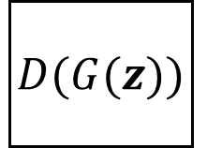
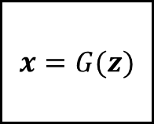


















GAN: The Adversarial Approach
Actual sample drawn from the actual data:
$$x\sim p_{data}$$
$$D\left(x\right)$$
$$D\left(x\right)→1$$
Correct classification
Counterfeit sample if $G(z)$ is stronger:
$$x\sim p_{g}$$
$$z\sim p_{z} (z)$$
$$G(z)$$
$$x=G(z)$$
$$D(G(z))$$
$$D(G(z))→1$$
Incorrect classification: $G(z)$ “deceived” $D\left(x\right)$
The adversarial relation between $G(z)$ and $D\left(x\right)$
Counterfeit sample if $D\left(x\right)$ is stronger:
$$x\sim p_{g}$$
$$z\sim p_{z} (z)$$
$$G(z)$$
$$x=G(z)$$
$$D(G(z))$$
$$D(G(z))→0$$
Correct classification: $G(z)$ failed to “deceive” $D\left(x\right)$

Slide 33

Generative Adversarial Networks
The objective function: $\min_{G}{\max_{D}{V\left(D,G\right)=𝔼_{x\sim p_{data}}\left[\log{D\left(x\right)}\right]+𝔼_{z\sim p_{z}}\left[\log\left(1−D\left(G\left(z\right)\right)\right)\right]}}$
First term (1): the cross-entropy loss of assigning labels for $x\sim p_{data}$. The better $D(x)$ classifies samples from the actual data the higher this term will be.
Second term (2): the cross-entropy loss of assigning labels for $x\sim p_{g}$. The better $D(x)$ classifies “counterfeit” samples the higher this term will be; the better $G(z)$ generates “counterfeit” samples the lower this term will be.
This min-max objective function can be further interpreted as:
Maximizing the discriminative loss: $\max_{D}{𝔼_{x\sim p_{data}}\left[\log{D\left(x\right)}\right]+𝔼_{z\sim p_{z}}\left[\log\left(1−D\left(G\left(z\right)\right)\right)\right]}$
And simultaneously minimizing the generative loss: $\min_{G}𝔼_{z\sim p_{z}}\left[\log\left(1−D\left(G\left(z\right)\right)\right)\right]$
(1)
(2)

Slide 34



Training Generative Adversarial Networks
Steps (Goodfellow et al. 2016):
Generative network $G$ (multi-layer CNN) receives random vectors $z$ from a uniform distribution $p_{z}$ as input and generates fake samples.
Discriminative network $D$ (multi-layer CNN) discriminates fake samples produced by the generative network and the actual ones.
Error Computing: cross-entropy loss is computed with the error between $D$’s prediction and ground truth.
Backpropagation: update network parameters $θ_{g}$ (for $G$) and $θ_{d}$ (for $D$)based on error.
Repeating steps 1-4: until GAN reaches equilibrium
Fig. 11. Illustration of the GAN training algorithm: G(z; $θ_{g}$) is the generative network; D(x; $θ_{d}$) is the discriminative network; $p_{data}$ is true distribution; $p_{z}$ is a simple distribution of random vectors (e.g., uniform distribution).

Slide 35






Training Generative Adversarial Networks
Equilibrium:
If both models have sufficient capacity, then the equilibrium of this game is reached when the $G(z)$ resembles the data generating distribution.
Therefore, the discriminative network cannot differentiate “counterfeit” samples versus actual data samples: $D\left(x\right)=\frac{1}{2}$.
$D(x)$
$$p_{data}$$
(a) Begin with the initial model.
(b) After updating $D$, the $D(x)$ is improved to differentiate actual samples from “counterfeit” samples. (c) After updating $G(z)$, $p_{g}$ is improved to “deceive” $D(x)$. (d) After several iterations, the data distribution $p_{data}$ equals to $p_{g}$ and therefore $D\left(x\right)=\frac{1}{2}$.
Counterfeit distribution $p_{g}$
(a)
(b)
(c)
(d)
Fig. 12. The Process of Reaching the Equilibrium

Slide 36



TensorFlow (Python) GAN Example: Hand-written Digits Generation
D_W1 = tf.Variable(xavier_init([784, 128]))
D_b1 = tf.Variable(tf.zeros(shape=[128]))
D_W2 = tf.Variable(xavier_init([128, 1]))
D_b2 = tf.Variable(tf.zeros(shape=[1]))
theta_D = [D_W1, D_W2, D_b1, D_b2]
def discriminator(x):
D_h1 = tf.nn.relu(tf.matmul(x, D_W1) + D_b1)
D_logit = tf.matmul(D_h1, D_W2) + D_b2
D_prob = tf.nn.sigmoid(D_logit)
return D_prob, D_logit
G_W1 = tf.Variable(xavier_init([100, 128]))
G_b1 = tf.Variable(tf.zeros(shape=[128]))
G_W2 = tf.Variable(xavier_init([128, 784]))
G_b2 = tf.Variable(tf.zeros(shape=[784]))
theta_G = [G_W1, G_W2, G_b1, G_b2]
def generator(z):
G_h1 = tf.nn.relu(tf.matmul(z, G_W1) + G_b1)
G_log_prob = tf.matmul(G_h1, G_W2) + G_b2
G_prob = tf.nn.sigmoid(G_log_prob)
return G_prob
Initializing weights and biases of discriminative network $D(x)$
*Note: xavier_init() is a commonly used function for initializing weights
Constructing the discriminative network $D(x)$
Initializing and constructing the generative network $G(z)$
*Complete python code can be found in the appendix.

Slide 37

TensorFlow (Python) GAN Example: Hand-written Digits Generation
X = tf.placeholder(tf.float32, shape=[None, 784])
Z = tf.placeholder(tf.float32, shape=[None, 100])
G_sample = generator(Z)
D_real, D_logit_real = discriminator(X)
D_fake, D_logit_fake = discriminator(G_sample)
D_loss = -tf.reduce_mean(tf.log(D_real) + tf.log(1. - D_fake))
D_solver = tf.train.AdamOptimizer().minimize(D_loss, var_list=theta_D)
G_loss = -tf.reduce_mean(tf.log(D_fake))
G_solver = tf.train.AdamOptimizer().minimize(G_loss, var_list=theta_G)
mb_size = 128; Z_dim = 100
mnist = input_data.read_data_sets('./MNIST_data', one_hot=True)
sess = tf.Session()
sess.run(tf.global_variables_initializer())
for it in range(100000):
X_mb, _ = mnist.train.next_batch(mb_size)
_, D_loss_curr = sess.run([D_solver, D_loss], feed_dict={X: X_mb, Z: sample_Z(mb_size, Z_dim)})
_, G_loss_curr = sess.run([G_solver, G_loss], feed_dict={Z: sample_Z(mb_size, Z_dim)})
samples = sess.run(G_sample, feed_dict={Z: sample_Z(16, Z_dim)})
Constructing the generative adversarial network
Formulating the discriminative loss for minimization and the inverse generative loss for minimization (equivalent to maximizing generative loss)
TensorFlow configuration and data preparation
Iteratively optimize the objective function with data sampled from the mnist dataset
Generate samples with random hidden variable $z$
*Complete python code can be found in the appendix.

Slide 38


TensorFlow (Python) GAN Example: Hand-written Digits Generation
samples = sess.run(G_sample, feed_dict={Z: sample_Z(16, Z_dim)})
Recall:
def generator(z):
G_h1 = tf.nn.relu(tf.matmul(z, G_W1) + G_b1)
G_log_prob = tf.matmul(G_h1, G_W2) + G_b2
G_prob = tf.nn.sigmoid(G_log_prob)
return G_prob
Generated samples
Input
Generative Network
16 random vectors from $Ν\left(0,I\right)$; each vector has 100 dimensions;
First fully connected layer with ReLU
Second fully connected layer with Sigmoid
Plot
Fig. 13. GAN for Digit Generation
z:np.random.randn(16, z_dim)

Slide 39
GAN Variants
Lately, numerous GAN variants have been proposed. The following table summarizes the major GAN variants for future references.
Models | Study | Data | Generated samples | Major features
Wasserstein GAN | Arjovsky et al. 2017 | LSUN | bedroom images | Uses Wasserstein distance as the loss function to train GAN.
Least Squares GAN | Mao et al. 2017 | LSUN; HWDB1.0 | bedroom images; Chinese characters | Uses least squares as loss function to train GAN (as opposed to cross-entropy loss.)
Deep Convolutional GAN | Radford and Metz 2016 | LSUN; Facial images; IMAGENET | bedroom images; facial images; natural images | Uses CNN as both the generator and the discriminator.
InfoGANs | Chen et al. 2016 | MNIST; CelebA; chair image dataset | Digit, chair images, facial images | An information-theoretic extension to GAN
Energy-based GAN | Zhao et al. 2016 | MNIST; LSUN; CelebA | Digit, bedroom, facial images | Treats discriminator as an energy function.
Table 1: Selected GAN Variants
*Note: MNIST is a public handwritten digit dataset; CelebA is a public human face dataset; LSUN is a public bedroom image dataset; HWDB1.0 is a Chinese character dataset;

Slide 40

VAE v.s. GAN: How to Choose?
While VAE and GAN can solve similar problems, the following table compares and contrasts the major properties of the two. Future research can leverage this table to make proper model selection.
Variational Autoencoder (VAE) | Generative Adversarial Networks (GAN)
The likelihood of data $p(x)$ can be calculated analytically; therefore, VAE allows for inference queries and can be incorporated into other generative probabilistic models. | The likelihood of data $p(x)$ cannot be readily calculated as it is not explicitly modeled in the objective function.
Domain knowledge can be incorporated into latent variables by specifying the prior distribution $p(z)$ and the posterior distribution $q(z|x)$. | Domain knowledge is hard to be incorporated because $G\left(z;θ_{g}\right)$ learns data generating process directly from the data.
Discrete latent variables are not allowed. | Discrete data cannot be modeled in general.
Model training is relatively easy compared with GAN. | Model training is difficult to reach the equilibrium.
The latent variables are interpretable. | The resulting model lacks interpretability.
Ideal for modeling latent distribution | Optimized for generative tasks
Table 2: Comparison of VAE versus GAN

Slide 41
Outline
Introduction
Traditional Generative Models
Deep Generative Models
Example Applications
Deep Belief Networks
Variational Autoencoder
Technical novelties
Implementation
Generative Adversarial Networks
Technical novelties
Implementation
Research Example: Motion Sensor-Based Fall Detection and Prediction
Conclusions
Appendix

Slide 42
Motion Sensor-Based Fall Detection and Prediction: A Hidden Markov Model and Generative Adversarial Network Approach
Research Example
Yidong Chai, Shuo Yu, Sagar Samtani, Hongyan Liu, Hsinchun Chen
Artificial Intelligence Lab, The University of Arizona

Slide 43
Introduction
Population aging is a growing societal concern.
In 2015, 8.5% of people worldwide (617 million) were aged 65 and over (NIH, 2015).
Falls are common among the elderly.
In the US, 28.7% of senior citizens aged 65 and older fell in 2014.
Falls are threats to senior citizens.
Leading cause of injury/death among older Americans (CDC, 2016)
Fall risk assessment (detection and prediction) can alleviate the threat of falls (Tong et al. 2013).
Prompt assistance can reduce the risk of hospitalization by 26% and death by over 80% (Scheffer et al., 2008).
Wearable motion sensor-based systems for fall risk assessment
Components: data collection; data transmission; data analysis

Slide 44
Introduction
Past motion sensor based studies have adopted two approaches for fall risk assessment:
Approach 1: Treat signals as independent samples: feature engineering + classifiers (Silva and Sousa, 2016)
Limitation: missing state transition information (e.g., if the current state is normal, the next state is more likely to be normal.) (Fig. 14)
Approach 2: Treat signals as both sequential and independent samples: feature engineering + Hidden Markov Model (HMM) (Cao et al., 2016)
Limitation 1: feature engineering → ad-hoc, manual, requires considerable domain knowledge; may not generalize.
Limitation 2: HMM assumes mixture Gaussian distributions to build HMM with Gaussian mixture models (GMM) for sensor signals, which affects overall performance when snippets are high-dimensional or distribution is not suitable to be modeled by GMM.
Fig. 14. Independent Information and Sequential Information

Slide 45

Approach2: Treat Signals as Both Sequential and Independent Samples by Involving HMM & GMM
HMM: a statistical model that models a Markov process with hidden states and observations.
The distribution of the observation at each time is governed by the emission probability of each state.
The probability of hidden state at each time is controlled by the transition probability given the last hidden state.
GMM: probabilistic model that assumes observations are generated from a mixture of Gaussian distributions.
HMM-GMM: In HMMs, GMMs are typically chosen as emission distribution models to generate continuous observations (i.e., continuous likelihood values) (Chatzis, 2010).
Approach 2 in a 5-step procedure (Fig. 15):
Segment signals to snippets
Engineer features
Build HMM-GMM
Each HMM state adopts a GMM to model the distribution of the segmented snippets.
Learn HMM-GMM with Baum-Welch algorithm
State transition probabilities and GMM parameters are both learned (Rabiner, 1989).
HMM-GMM inference for fall risk assessment:
Given a new observation, infer the most likely state based on the trained model.
Predict the most likelihood state given the current inferred state.
Fig. 15. HMM-GMM Architecture for Fall Risk Assessment
Note: x(t) is the state at time t. y(t) is the features at time t.

Slide 46
Approach2: Treat Signals as Both Sequential and Independent Samples by Involving HMM & GMM
HMM-GMM Learning: Baum–Welch algorithm
A special case of the expectation-maximization (EM) algorithm.
E-step to obtain expected likelihood. The observation likelihood is calculated from GMM.
Forward procedure: for each time t, calculate probability of each state at time t plus seeing the current and previous observations.
Backward procedure: for each time t, calculate probability of each state at time t plus seeing the future observations.
M-step to update parameters to maximize the expected likelihood.
HMM-GMMs has two limitations:
Feature engineering → ad-hoc, labor-intensive, may not generalize
Assume mixture Gaussian distribution.
Not a valid assumption when signal snippets increase in dimensionality.
As deep generative models are good at learning excellent distributions from complicated data, it can tackle these problems.

Slide 47
Deep Generative Models
Deep generative models obtain the joint probability of a sample and a label (i.e., p(x,y)). This enables us to calculate the likelihood of sample given an label (i.e., p(x|y)).
Analogous to the calculation of observation likelihood given the state, which is necessary for HMM learning and inference.
Therefore, we choose deep generative models in this research.
Common deep generative models include variational autoencoders (VAEs) and generative adversarial networks (GANs).
GANs have several advantages over VAEs:
GANs lead to the exact data distribution with infinite data and a large model, while VAEs may not lead to the exact data distribution even with infinite data and a large model. (Goodfellow, 2016)
GANs tend to generate better samples than the other deep learning models
Therefore, we focus on GANs in this research.

Slide 48
Literature Review – Likelihood Calculation Methods for Generative Adversarial Networks
While the GANs’ generative networks can address prevailing limitations of GMMs, they cannot directly replace GMMs in HMMs:
GANs lack an explicit probability distribution. Computing the exact likelihood is intractable.
Observation likelihood values are required by the conventional Baum-Welch algorithm for HMM learning (i.e., the forward and backward procedures rely on observation likelihood values).
These limitations necessitate an approximation algorithm to obtain observation likelihoods.
Two prevailing methods can approximate likelihoods for GANs: Kernel Density Estimator (KDE) (Parzen, 1962) and Annealed Importance Sampling (AIS) (Neal, 2001)
Recent work notes AIS is preferred, as KDE is inaccurate with high-dimensional data (Wu et al., 2017).
AIS is much more accurate than KDE (two orders of magnitude) (Wu et al., 2017)

Slide 49
Research Gaps and Questions
We identified several domain and methodological gaps within extant literature.
Domain: Current approaches for fall risk assessment have several key drawbacks.
Independent samples: missing sequential (state transition) information
Sequential samples: feature engineering (ad-hoc, not generalizable) and GMM.
Methodological:
HMMs typically use GMMs to calculate observation likelihoods.
However, the mixture Gaussian assumption is not valid in some cases.
GANs learn distributions (Gaussian or otherwise) without feature engineering, but their likelihood is intractable (required by the Baum-Welch HMM training algorithm).
AIS can approximate observation likelihoods for GANs, but we are unaware of any approaches integrating this technique into an HMM.

Slide 50
Research Gaps and Questions
These gaps motivate the following research questions:
Question 1: How can HMM’s GMM be replaced with a GAN such that both independent and sequential information can be captured from varying data distributions without manual feature engineering?
Question 2: How can AIS be used to generate likelihood values of GANs for subsequent integration into HMM training procedures?
Question 3: How can an integrated HMM-GAN model be used to improve performance fall risk assessment (detection and prediction) over the previous benchmark systems?
To answer these questions, we developed a novel fall risk assessment research framework with four major components (Fig. 16).

Slide 51







Research Design
Data Collection
Data Pre-Processing
HMM-Generative Adversarial Network
Fall Risk Assessment Case Study
Sensor Attachment
Signal Segmentation
HMM-GAN
Fall Detection
Data Collection
Snippet Labelling
Benchmark Experiments
Fall Prediction
Fig 16. Research Design

Slide 52

Research Design – Data Collection
Two publicly available FARSEEING and UR datasets were identified.
Selected studies using FARSEEING or UR Fall include: Broadley et al., 2018; Khojasteh et al., 2018; Shuo et al., 2017; Guo et al., 2017; Yun et al., 2015; Baldewijns et al., 2015.
FARSEEING (real-world dataset):
22 real falls captured using accelerometers with sampling frequency of 20 Hz.
Each fall contains signals and a corresponding report describing subject profile, sensor information, caused injuries, and context of the fall.
UR Fall Detection (simulated dataset) (Kwolek et al., 2014):
30 synthetic fall sequences, each having a corresponding video recorded.
Consistent with common practice in past literature examining motion-sensor based fall risk assessment, we segment signal data into snippets using a sliding window (Özdemir and Barshan 2014; Shuo et al., 2017).
Acceleration magnitude$(i.e., acc=\sqrt{x_{acc}^{2}+y_{acc}^{2}+z_{acc}^{2}}$) is computed to avoid sensor orientation misalignment (Tong et al., 2013).

Slide 53

Research Design – From HMM-GMM to HMM-GAN
Fig. 17 A Breakup on HMM-GMM and HMM-GAN models.
(a) Left: Traditional HMM-GMM Architecture; (b) Right: Proposed HMM-GAN Architecture
The main model novelty is highlighted in red in Fig. 17b.
HMM-GAN, we (1) substitute GMMs with the generative networks learned from GANs, (2) include AIS approximation for calculating observation probabilities for inference.
Intuition: Using neural networks in an adversarial strategy (i.e., employing GAN), we can better learn underlying data distributions of snippets as compared to traditional GMMs.

Slide 54
Research Design – Difficulty in HMM-GAN Training
The parameters of HMM-GAN (state transition probabilities and emission probabilities (i.e., probability implied by GAN)) cannot be jointly obtained via the conventional Baum-Welch HMM learning algorithm.
No explicit probability distribution in GANs; therefore observation likelihoods are intractable (Goodfellow, 2016).
In the Baum-Welch algorithm, observation likelihood are required in the E-step (i.e., the forward and backward procedure to calculate expectation likelihood).
Without an observation likelihood, E-step can not be implemented. As M-step is based on the output of E-step, both E-step and M-step cannot be implemented.
Therefore, HMM-GAN can not be learned in this way.

Slide 55
Research Design – HMM-GAN Learning Process
Solution: a three-step learning process (Fig. 18)
Step 1: Train GAN for each state independently to obtain emission probability of each state of HMM-GAN (i.e., probability contained in GAN);
Input: snippets of different states
Output: GANs for each state
Step 2: Apply AIS on the trained GANs to approximate observation likelihoods for each state of HMM-GAN;
Input: snippets and GANs trained
Output: likelihood of each snippet
Step 3: Run the Baum-Welch algorithm to learn state transition probabilities based on observation likelihoods obtained in Step 2.
Input: likelihood of each snippet
Output: state transition probabilities
Note: although Baum-Welch is used to learn state transition and emission probabilities in HMMs, we only use it to learn the former as we already obtained the latter in Step 1.
Step 1
Step 2
Step 3
Train GAN for each state independently
Apply AIS on the trained GANs
Run Baum-Welch algorithm
Fig. 18. Diagram of HMM-GAN Learn Process

Slide 56

Research Design – Fall Risk Assessment
After the HMM-GAN is fully trained, we use it for fall risk assessment.
Denote x(t) as the hidden state (falling/non-falling) at time t; y(t) as the observed sensor signal.
Fall detection: Given the fall risk at time t-1 and acceleration signal at time t, infer the fall risk at time t.
$$p\left(x\left(t\right) | y\left(t\right),x(t−1)\right)=\frac{p\left(y\left(t\right) | x\left(t\right)\right)p\left(x\left(t\right)|x(t−1)\right)}{p\left(y\left(t\right)\right)}\sim p\left(y\left(t\right) | x\left(t\right)\right)p\left(x\left(t\right)|x(t−1)\right)$$
Fall prediction: Only given the fall risk at time t, infer the fall risk at time t+1.
$$p\left(x\left(t+1\right)\right)←p\left(x\left(t+1\right)|x\left(t\right)\right)$$

Slide 57
Research Design – HMM-GAN Evaluation Experiments
We rigorously evaluate the proposed HMM-GAN with three sets of experiments:
Experiment 1 (internal evaluation): Evaluate the quality of GAN-generated snippets by using the generated snippets as inputs for down stream tasks
Experiment 2 (external evaluation): Evaluate the quality of HMM-GAN’s learned state transition distributions and signal distributions
Experiment 3 (external evaluation): HMM-GAN fall detection and prediction performances

Slide 58
Experiment 1– Quality of GAN Snippets
The procedure is the same as Santurkar et al., 2018
Fig. 19. Classifier Comparison for FARSEEING and UR Fall Dataset
Results indicate that differences in performances in accuracy, precision, recall, and F1 were marginal (max 0.0742).
Overall, Experiment 1 results suggest that GAN can effectively learn and model the real dataset and generate a nearly identical output.
The GANs we have trained can recover the underlying distributions of different sensor snippet types.

Slide 59
Experiment 2 – Overview and Results
Experiment 2 examines the HMM-GAN’s ability to model the whole signal compared to the traditional HMM-GMM.
We compared the log likelihood of HMM-GMM models against HMM-GAN
The likelihood can be seen as a degree of how well the model matches the observations. Therefore, the better model should achieve a higher likelihood value (Lawrence, 1989).
Overall, HMM-GANs’ higher likelihood values indicate its ability to better capture the underlying data distribution of both datasets as compared to GMM’s Gaussian assumption.
Models | Averaged Log-Likelihood
 | FARSEEING | UR Dataset
HMM-GMM(1) | -133674*** | -56931***
HMM-GMM(3) | -129521*** | -56895.9***
HMM-GMM(5) | -182526*** | -56725.5***
HMM-GMM(7) | -128181*** | -56941.5***
HMM-GAN | 2967.736 | 308.396
Table 3. Averaged Log-likelihood Comparison
Note: *** for p<0.001
Fig 20. Log-likelihood Comparison for FARSEEING Dataset
Fig 21. Log-likelihood Comparison for UR Dataset
Note: ‘sn’ is the n-th fall sequence
Note: ‘sn’ is the n-th fall sequence

Slide 60

Experiment 3 Overview
Experiment 3 benchmarks the HMM-GAN’s performance in fall detection and prediction against state-of-the-art benchmark methods (Sekine et al., 2013; Tong et al., 2013).
Experiment 3a: HMM-GAN vs. methods only using in-state information.
Acceleration Root Means Squared (ARMS): $ARMS=\sqrt{\frac{1}{M}\sum_{m=1}^{M}{a_{m}^{2}}}$, where M is the length of snippet and $a_{m}$ is acceleration magnitude of m-th point of a snippet (Howcroft et al., 2013).
Peak and valley method: set upper fall threshold as the smallest magnitude of the signal peaks and set lower fall threshold as the smallest magnitude of the signal valleys.
If a snippet’s magnitude is outside the thresholds, it is classified as a fall snippet (Bourke et al., 2007).
3, 4, 5 layer CNNs: although there has been no deep learning models built for fall detection in published work, we still design a series of CNNs for comparison.
Experiment 3b: HMM-GAN vs. methods using in-state information and state-transition information.
HMM-GMMs with 3, 5, 7 components to model acceleration magnitude.
HMM with acceleration time series (ATS) features (HMM-ATS).
Extract ATS features of each snippet following the same procedure of Tong et al. (2013).
Then we use a Gaussian distribution as emission probability distribution to model the ATS features.
Accuracy, precision, recall, and F1 measured performances, with paired t-tests identified statistically significant differences between methods.

Slide 61
Experiment 3a – Results
Fig. 22. Fall Detection Results with FARSEEING Dataset
Fig. 23. Fall Detection Results with UR Fall Dataset
Fig. 24. Fall Prediction Results with FARSEEING Dataset
Fig. 25. Fall Prediction Results with UR Fall Dataset

Slide 62
Experiment 3a – Results Discussion
Overall, HMM-GAN outperformed all methods treating samples independently (Threshold method, ARMS, CNN) in both fall detection and prediction.
Performance differences were statistically significant.
Possible explanations: HMM-GAN make use of state transition information and in-state information while the other models only utilize in-state information.
Indicates that including information about prior states improve fall detection and prediction.
Results of HMM-GAN against methods using both information types for fall detection and prediction are summarized in Fig. 26-29.

Slide 63
Experiment 3b – Results
Fig. 26. Fall Detection Results with FARSEEING Dataset
Fig. 27. Fall Detection Results with UR Fall Dataset
Fig. 28. Fall Prediction Results with FARSEEING Dataset
Fig. 29. Fall Prediction Results with UR Fall Dataset

Slide 64
Experiment 3b – Results Discussion
Overall, HMM-GAN outperformed all methods using both information types in accuracy, precision, and F1.
Performance differences were statistically significant.
This indicates that even among methods using both information types, HMM-GAN can better predict and detect falls.
Possible explanation: GAN’s can better recover the underlying data distributions of datasets.

Slide 65


Case Study – Fall Detection
We illustrate HMM-GAN’s practical value with an in-depth case study.
Demonstrate case study with UR dataset, as each of the 30 fall sequences is accompanied with a video.
Fall correctly detected by HMM-GAN, but missed by best competing approach
3-layer CNN.
Fig. 30. A Fall Sequence in UR Fall Dataset
Note: “sn” means the n-th snippets; each snippet is shown using different color.
We compare HMM-GAN with the best benchmark model, CNN(3)), for fall detection.
HMM-GAN labeled s11 as fall state (see actual fall screenshot in Fig. 30), while CNN(3) classified the s11 as non-fall.

Slide 66


Case Study – Fall Prediction
Fall correctly predicted by HMM-GAN, but missed by best competing approach
3-layer CNN. Fall was predicted with a 73.8% confidence.
Fig. 31. A Fall Sequence in UR Fall Dataset
Note: “sn” means the n-th snippets; each snippet is shown using different color.
We compare HMM-GAN with the model with the highest F1 (CNN(3)) for fall prediction.
HMM-GAN predicted s6 as falling state (as shown in Fig. 31) while the CNN(3) predicted the s6 as non-falling.

Slide 67
Outline
Introduction
Traditional Generative Models
Deep Generative Models
Example Applications
Deep Belief Networks
Variational Autoencoder
Technical novelties
Implementation
Generative Adversarial Networks
Technical novelties
Implementation
Research Example: Motion Sensor-Based Fall Detection and Prediction
Conclusions
Appendix

Slide 68
Conclusions
Deep generative models extend traditional generative modeling by allowing for modeling complex data generating distributions with improved computational efficiency.
The most representative deep generative models include Deep Belief Networks (DBN), Variational Autoencoders (VAE), and Generative Adversarial Networks (GAN).
DBN uses energy-based generative models for layer-wise pre-training.
VAE leverages the autoencoder architecture to find the posterior distributions.
GAN utilizes the adversarial approach to emulate the data generating distribution.
TensorFlow has been the most popular package for deep generative modeling.
In addition to the example applications shown in the slides, applications of deep generative models further include:
Sensor data analytics, semi supervised learning, imitation learning, adversarial examples, compressed sensing, machine translation, etc.

Slide 69
Outline
Introduction
Traditional Generative Models
Deep Generative Models
Example Applications
Deep Belief Networks
Variational Autoencoder
Technical novelties
Implementation
Generative Adversarial Networks
Technical novelties
Implementation
Research Example: Motion Sensor-Based Fall Detection and Prediction
Conclusions
Appendix

Slide 70
VAE Code
# Generate samples by P(z)
def P(z):
h = tf.nn.relu(tf.matmul(z, P_W1) + P_b1)
logits = tf.matmul(h, P_W2) + P_b2
prob = tf.nn.sigmoid(logits)
return prob, logits
#Input sample and generate a new one
z_mu, z_logvar = Q(X)
z_sample = sample_z(z_mu, z_logvar)
_, logits = P(z_sample)
# Sampling from random z
X_samples, _ = P(z)
# calculate E[log P(X|z)]
recon_loss = tf.reduce_sum(tf.nn.sigmoid_cross_entropy_with_logits(logits=logits, labels=X), 1)
# calculate D_KL(Q(z|X) || P(z))
kl_loss = 0.5 * tf.reduce_sum(tf.exp(z_logvar) + z_mu**2 - 1. - z_logvar, 1)
# calculate total VAE loss
vae_loss = tf.reduce_mean(recon_loss + kl_loss)
# Set solver
solver = tf.train.AdamOptimizer().minimize(vae_loss)
# create and initialize tensorflow session
sess = tf.Session()
sess.run(tf.global_variables_initializer())
if not os.path.exists('out/'):
os.makedirs('out/')
i = 0
for it in range(100000):
# Generate a batch of training data
X_mb, _ = mnist.train.next_batch(mb_size)
# Update parameters to minimize the vae loss
_, loss = sess.run([solver, vae_loss], feed_dict={X: X_mb})
# Print loss and visualize generated samples to track the training process.
if it % 1000 == 0:
print('Iter: {}'.format(it))
print('Loss: {:.4}'. format(loss))
print()
samples = sess.run(X_samples, feed_dict={z: np.random.randn(16, z_dim)})
fig = plot(samples)
plt.savefig('out/{}.png'.format(str(i).zfill(3)), bbox_inches='tight')
i += 1
plt.close(fig)
# import package
import tensorflow as tf
import numpy as np
import matplotlib.pyplot as plt
import matplotlib.gridspec as gridspec
import os
from tensorflow.examples.tutorials.mnist import input_data
# Define training data
mnist = input_data.read_data_sets('./MNIST_data', one_hot=True)
mb_size = 64 # batch size
z_dim = 100 # dimension of a random vector
X_dim = mnist.train.images.shape[1]
y_dim = mnist.train.labels.shape[1]
h_dim = 128; c = 0; lr = 1e-3
# Define a function to initialize network weigh parameters
def xavier_init(size):
in_dim = size[0]
xavier_stddev = 1. / tf.sqrt(in_dim / 2.)
# Use normal distribution to initialize
return tf.random_normal(shape=size, stddev=xavier_stddev)
# define a function to visualize generated samples.
def plot(samples):
fig = plt.figure(figsize=(4, 4))
gs = gridspec.GridSpec(4, 4)
gs.update(wspace=0.05, hspace=0.05)
for i, sample in enumerate(samples):
ax = plt.subplot(gs[i])
plt.axis('off')
ax.set_xticklabels([])
ax.set_yticklabels([])
ax.set_aspect('equal')
plt.imshow(sample.reshape(28, 28), cmap='Greys_r')
return fig
# Inserts a placeholder for tensors that will be fed later.
X = tf.placeholder(tf.float32, shape=[None, X_dim])
z = tf.placeholder(tf.float32, shape=[None, z_dim])
# Initialization Encoder Weights and biases; they are treated as variables to update
Q_W1 = tf.Variable(xavier_init([X_dim, h_dim]))
Q_b1 = tf.Variable(tf.zeros(shape=[h_dim]))
Q_W2_mu = tf.Variable(xavier_init([h_dim, z_dim]))
Q_b2_mu = tf.Variable(tf.zeros(shape=[z_dim]))
Q_W2_sigma = tf.Variable(xavier_init([h_dim, z_dim]))
Q_b2_sigma = tf.Variable(tf.zeros(shape=[z_dim]))
# Generate mean and std of z
def Q(X):
h = tf.nn.relu(tf.matmul(X, Q_W1) + Q_b1)
z_mu = tf.matmul(h, Q_W2_mu) + Q_b2_mu
z_logvar = tf.matmul(h, Q_W2_sigma) + Q_b2_sigma
return z_mu, z_logvar
# Sample z using reparameterization trick
def sample_z(mu, log_var):
eps = tf.random_normal(shape=tf.shape(mu))
return mu + tf.exp(log_var / 2) * eps
# Initialization Decoder Weights and biases; they are treated as variables to update
P_W1 = tf.Variable(xavier_init([z_dim, h_dim]))
P_b1 = tf.Variable(tf.zeros(shape=[h_dim]))
P_W2 = tf.Variable(xavier_init([h_dim, X_dim]))
P_b2 = tf.Variable(tf.zeros(shape=[X_dim]))

Slide 71
GAN Code
G_sample = generator(Z)
D_real, D_logit_real = discriminator(X)
D_fake, D_logit_fake = discriminator(G_sample)
# calculate discriminator loss
D_loss = -tf.reduce_mean(tf.log(D_real) + tf.log(1. - D_fake))
# calculate generator loss
G_loss = -tf.reduce_mean(tf.log(D_fake))
# Set solvers for discriminator and generator
D_solver = tf.train.AdamOptimizer().minimize(D_loss, var_list=theta_D)
G_solver = tf.train.AdamOptimizer().minimize(G_loss, var_list=theta_G)
mb_size = 128 # batch size
Z_dim = 100 # dimension of the random vector
mnist = input_data.read_data_sets('./MNIST_data', one_hot=True)
# create and initialize tensorflow session
sess = tf.Session()
sess.run(tf.global_variables_initializer())
if not os.path.exists('out/'):
os.makedirs('out/')
i = 0
for it in range(100000):
if it % 1000 == 0:
# Generate fake samples, i.e., input Z and output G_sample
samples = sess.run(G_sample, feed_dict={Z: sample_Z(16, Z_dim)})
# Visualize the generated samples
fig = plot(samples)
plt.savefig('out/{}.png'.format(str(i).zfill(3)), bbox_inches='tight')
i += 1
plt.close(fig)
# Generate a batch of training data
X_mb, _ = mnist.train.next_batch(mb_size)
# Update parameters to minimize D_loss and G_loss
_, D_loss_curr = sess.run([D_solver, D_loss], feed_dict={X: X_mb, Z: sample_Z(mb_size, Z_dim)})
_, G_loss_curr = sess.run([G_solver, G_loss], feed_dict={Z: sample_Z(mb_size, Z_dim)})
# Print loss to track the training process.
if it % 1000 == 0:
print('Iter: {}'.format(it))
print('D loss: {:.4}'. format(D_loss_curr))
print('G_loss: {:.4}'.format(G_loss_curr))
print()
# import package
import tensorflow as tf
from tensorflow.examples.tutorials.mnist import input_data
import numpy as np
import matplotlib.pyplot as plt
import matplotlib.gridspec as gridspec
import os
# Define a function to initialize network weigh parameters
def xavier_init(size):
in_dim = size[0]
xavier_stddev = 1. / tf.sqrt(in_dim / 2.)
# Use normal distribution to initialize
return tf.random_normal(shape=size, stddev=xavier_stddev)
# Inserts a placeholder for a tensor that will be fed later.
X = tf.placeholder(tf.float32, shape=[None, 784])
# weights and biases are treated as variables; add them to the computational graph to train
D_W1 = tf.Variable(xavier_init([784, 128]))
D_b1 = tf.Variable(tf.zeros(shape=[128]))
D_W2 = tf.Variable(xavier_init([128, 1]))
D_b2 = tf.Variable(tf.zeros(shape=[1]))
# concatenate them for simplicity.
theta_D = [D_W1, D_W2, D_b1, D_b2]
Z = tf.placeholder(tf.float32, shape=[None, 100])
G_W1 = tf.Variable(xavier_init([100, 128]))
G_b1 = tf.Variable(tf.zeros(shape=[128]))
G_W2 = tf.Variable(xavier_init([128, 784]))
G_b2 = tf.Variable(tf.zeros(shape=[784]))
theta_G = [G_W1, G_W2, G_b1, G_b2]
# define a function to sample a random vector
def sample_Z(m, n):
return np.random.uniform(-1., 1., size=[m, n])
# generator(z)
def generator(z):
# first fully connected operation with ReLU transformation
G_h1 = tf.nn.relu(tf.matmul(z, G_W1) + G_b1)
# second fully connected operation with sigmoid transformation
G_prob = tf.nn.sigmoid (tf.matmul(G_h1, G_W2) + G_b2)
return G_prob
def discriminator(x):
D_h1 = tf.nn.relu(tf.matmul(x, D_W1) + D_b1)
D_logit = tf.matmul(D_h1, D_W2) + D_b2
D_prob = tf.nn.sigmoid(D_logit)
return D_prob, D_logit
# define a function to visualize generated samples.
def plot(samples):
fig = plt.figure(figsize=(4, 4))
gs = gridspec.GridSpec(4, 4)
gs.update(wspace=0.05, hspace=0.05)
for i, sample in enumerate(samples):
ax = plt.subplot(gs[i])
plt.axis('off')
ax.set_xticklabels([])
ax.set_yticklabels([])
ax.set_aspect('equal')
plt.imshow(sample.reshape(28, 28), cmap='Greys_r')
return fig

